Slide 1
Loan Repayment Assessment in Banking
-by Hari Santosh
hsgame08@gmail.com

Slide 2
This code is to mount the drive, import pandas , set the display option to view all columns, and read the train dataset
from google.colab import drive
drive.mount('/content/drive')
import pandas as pd
df = pd.read_csv("/content/drive/MyDrive/Hackathon_KH/train_loan_data (1).csv")
pd.set_option('display.max_columns', None)
df

Slide 3
I have used Ordinal encoder on the grade column because there is an inherent order on the loan grades
( Grade A being least risky therefore score of 1.0, Grade G being highest risk, therefore score of 7.0 )
from sklearn.preprocessing import OrdinalEncoder
# Initialize the OrdinalEncoder
encoder = OrdinalEncoder()
# Fit and transform the feature
df['grade'] = encoder.fit_transform(df[['grade']])

Slide 4
This code is to convert emp_length column from object to number format so it can be used as model input feature.
mapping = {
'< 1 year': 0,
'1 year' : 1,
'2 years' : 2,
'3 years' : 3,
'4 years' : 4,
'5 years' : 5,
'6 years' : 6,
'7 years' : 7,
'8 years' : 8,
'9 years' : 9,
'10+ years': 10
}
# Map the corresponding values using the mapping dictionary
df['emp_length'] = df['emp_length'].map(mapping)
# Print the updated column
df['emp_length']

Slide 5
Converting the Target variable to number number by assigning 0 as defaulted, and 1 as Paid.
from sklearn.preprocessing import LabelEncoder
# Initialize the LabelEncoder
encoder = LabelEncoder()
# Fit the encoder to the data and transform the data
df['loan_status'] = encoder.fit_transform(df['loan_status'])

Slide 6
Here I have mapped the term column values to its number format to use in model input feature.
mapping = {
' 60 months' : 60 ,
' 36 months': 36
}
# Map the corresponding values using the mapping dictionary
df['term'] = df['term'].map(mapping)
# Print the updated column
df['term']

Slide 7
Checking for null values in the dataset
df.isnull().sum()
emp_length 4588
emp_title 5018
num_actv_bc_tl 3948
mort_acc 2771
tot_cur_bal 3948
pub_rec_bankruptcies 31
revol_util 53
title 970

Slide 8
Dropping specified rows because they have negligible amount of null values compared to dataset
# Drop the rows with null values in the 'pub_rec_bankruptcies','title','revol_util' column.
df = df.dropna(subset=['pub_rec_bankruptcies'])
df = df.dropna(subset=['revol_util'])
df = df.dropna(subset=['title'])

Slide 9
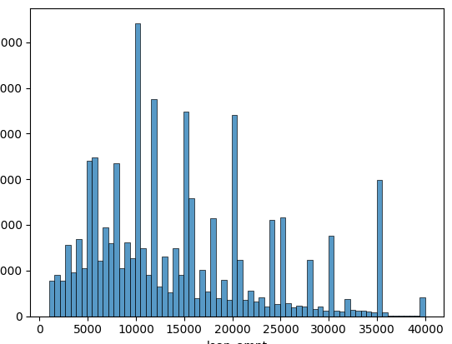
Checking the distribution of loan amount column.
import seaborn as sns
# Plot the distribution of a single feature
sns.histplot(df['loan_amnt'])

Slide 10
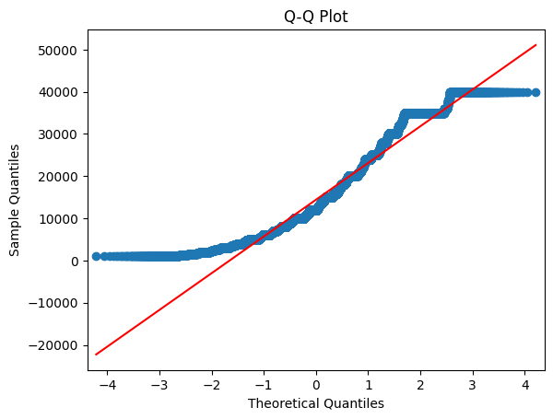
Checking the distribution of same feature loan amount using qq-plot, It can be confirmed its not normally distributed.
import statsmodels.api as sm
import matplotlib.pyplot as plt
fig = sm.qqplot(df['loan_amnt'], line='s')
plt.title("Q-Q Plot")
plt.xlabel("Theoretical Quantiles")
plt.ylabel("Sample Quantiles")
plt.show()

Slide 11
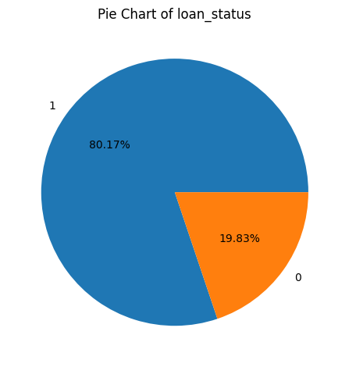
Here I plot the pie chart of the target variable loan_status, the Defaulted (0) class in low compared to Paid class, causing class imbalance
# Select the column you want to create a pie chart for
feature_column = 'loan_status'
# Calculate the value counts and percentages
value_counts = df[feature_column].value_counts()
percentages = value_counts / len(df) * 100
# Add a title to the chart
plt.title("Pie Chart of {}".format(feature_column))
# Add the percentages as text outside each slice
_, _, autotexts = plt.pie(value_counts, labels=value_counts.index, autopct='%.2f%%')
for autotext in autotexts:
autotext.set_horizontalalignment('center')
autotext.set_verticalalignment('center')
# Display the chart
plt.tight_layout()
# 1 Means PAID
# 0 means DEFAULTED

Slide 12
I use KNN imputer after trying out mean and median imputer as KNN imputer is less sensitive to outliers in features with null values.
from sklearn.impute import KNNImputer
import numpy as np
# Define the columns you want to impute
columns = ["num_actv_bc_tl", "mort_acc", "tot_cur_bal", "emp_length"]
# Create an instance of the KNNImputer
imputer = KNNImputer(n_neighbors=5) # You can adjust the number of neighbors to use
# Fit the imputer on the data with the specified columns
imputer.fit(df[columns])
# Impute the missing values in the specified columns
df[columns] = imputer.transform(df[columns])

Slide 13
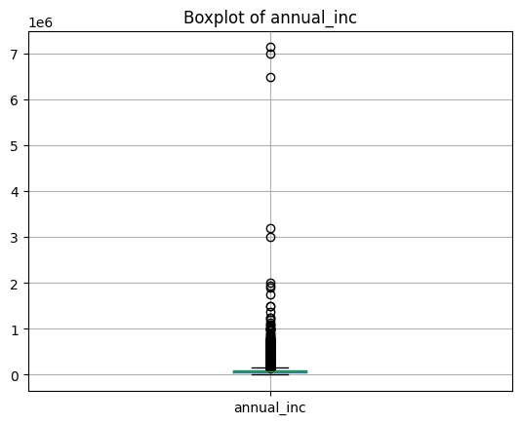
I have made a boxplot for each feature to detect outliers, The other boxplots look consistent enough except the annual_inc one.
numerical_df = df.select_dtypes(include=[np.number]).copy()
# Create a boxplot for each feature in the dataset
for column in numerical_df.columns:
plt.figure()
numerical_df.boxplot(column=column)
plt.title(f"Boxplot of {column}")
plt.show()

Slide 14
So to deal with outliers in the annual_inc feature, I have capped( Winsorize) the outliers ( lying above 99 percentile mark and below 1 percentile mark. This will make sure these values don't cause bias in the model training coefficients.
from scipy.stats import mstats
# Assuming you have a DataFrame called 'numerical_df' with your dataset
# and 'annual_inc' is the column you want to winsorize
# Specify the column you want to winsorize
column_to_winsorize = 'annual_inc'
# Winsorize the column at the 1st and 99th percentile
winsorized_data = mstats.winsorize(numerical_df[column_to_winsorize], limits=[0.01, 0.01])
# Replace the original column with the winsorized values
numerical_df[column_to_winsorize] = winsorized_data

Slide 15
In this code I have made a correlation matrix with respect to each feature with another. Also made a heatmap with correlation values and highlighting values which have great than 0.8 correlation value. Output in next slide
# Calculate the correlation matrix
correlation_matrix = numerical_df.corr()
# Print the correlation matrix
correlation_matrix
corr_matrix = correlation_matrix.copy()
# Set the threshold for high correlation.
threshold = 0.8
# Create a mask to highlight high values in the heatmap with high negative and positive correlation.
mask = abs(corr_matrix) <= threshold
# Set the values below the threshold to blank.
corr_matrix[mask] = 0
# Create a custom colormap to dim the rest of the values in the heatmap.
cmap = sns.diverging_palette(220, 10, as_cmap=True)
# Plot the heatmap.
ax1 = sns.heatmap(corr_matrix, annot=True, cmap=cmap)
plt.gcf().set_size_inches(15, 15)

Slide 16
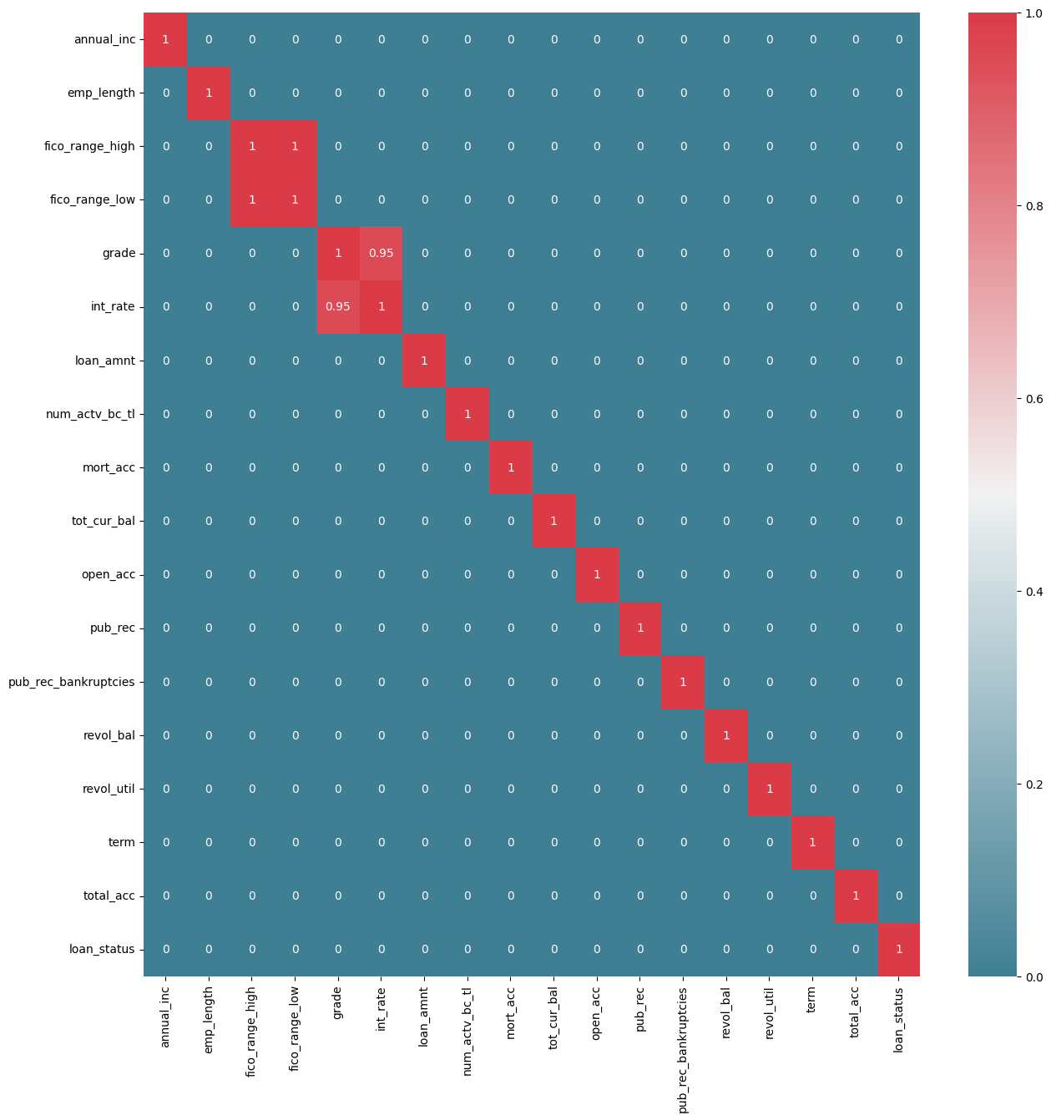
Here we can see grade and interest rate are highly correlated, which can cause multicollinearity and cause bias in the model. Therefore a way to deal with them is to combine both into a single feature. But since our problem is a classification task, I have left them as is.

Slide 17
Here we are splitting our dataset into predictor variables (X) and target variable (y) .
# Splitting dataset, all columns but last into X, and last column into Y
X = numerical_df.iloc[:,:-1]
Y = numerical_df.iloc[:, -1]

Slide 18
Since the target variable is imbalanced, I have tried various undersampling techniques and calculated the f1 score on each technique using the logistic regression classifier. The tomek links technique had the highest f1 score for this test so I have proceeded to use this undersampling technique with other models.
Note: I have used only logistic classifier here because the code would run for hours without any output when different models were mixed with different undersampling techniques.
# Split the data into a training set and a test set.
X_train, X_test, y_train, y_test = train_test_split(X, Y, test_size=0.2,shuffle= True,random_state=42)
# Make sure y_test is a NumPy array
y_test = np.array(y_test)
# Define the undersampling techniques to be used.
undersampling_techniques = ['random', 'tomek_links', 'smote']
# Initialize a dictionary to store the F1 scores for each undersampling technique.
f1_scores = {}
def undersample(x, y, technique):
"""Undersamples the training set.
Args:
X: A NumPy array containing the training data.
y: A NumPy array containing the class labels for the training data.
technique: The undersampling technique to use. Valid values are 'random',
'tomek_links', and 'smote'.
Returns:
A NumPy array containing the undersampled training data and a NumPy array
containing the class labels for the undersampled training data.
"""
if technique == 'random':
undersampler = RandomUnderSampler()
elif technique == 'tomek_links':
undersampler = TomekLinks()
elif technique == 'smote':
undersampler = SMOTE()
else:
raise ValueError('Invalid undersampling technique.')
X_undersampled, y_undersampled = undersampler.fit_resample(x, y)
return X_undersampled, y_undersampled

Slide 19
Code continued from previous slide
# Iterate over the undersampling techniques.
for technique in undersampling_techniques:
# Undersample the training set.
X_train_undersampled, y_train_undersampled = undersample(X_train, y_train, technique=technique)
# Scale the features in the undersampled training set.
scaler = StandardScaler()
X_train_undersampled = scaler.fit_transform(X_train_undersampled)
# Train a logistic regression classifier on the undersampled and scaled training set.
clf = LogisticRegression()
clf.fit(X_train_undersampled, y_train_undersampled)
# Evaluate the classifier on the test set.
X_test_scaled = scaler.transform(X_test)
y_pred = clf.predict(X_test_scaled)
f1 = f1_score(y_test, y_pred)
# Store the F1 score in the dictionary.
f1_scores[technique] = f1
# Print the F1 scores for each undersampling technique.
for technique, f1_score in f1_scores.items():
print(f'{technique}: {f1_score}')
# Select the undersampling technique with the highest F1 score.
best_technique = max(f1_scores, key=f1_scores.get)
# Print the best undersampling technique.
print(f'Best undersampling technique: {best_technique}')

Slide 20
Here are the required modules and functions for implementing the previous 2 slides code, also attached is the output f1 scores. We use standard scaler here because the certain features in the train/test data are in different scale compared to the others, therefore normalising all features separately.
from imblearn.under_sampling import RandomUnderSampler
from imblearn.over_sampling import SMOTE
from imblearn.under_sampling import TomekLinks
from sklearn.model_selection import train_test_split
from sklearn.linear_model import LogisticRegression
from sklearn.metrics import f1_score
from sklearn.preprocessing import StandardScaler
random: 0.7601578616916316
tomek_links: 0.884461864863893
smote: 0.7606864274570985
Best undersampling technique: tomek_links

Slide 21
Importing the required modules for models, undersampling, train test split,standard scaler and f1 score.
from imblearn.under_sampling import TomekLinks
from sklearn.model_selection import train_test_split
from sklearn.linear_model import LogisticRegression
from sklearn.metrics import f1_score
from sklearn.preprocessing import StandardScaler
from sklearn.tree import DecisionTreeClassifier
from sklearn.ensemble import RandomForestClassifier, GradientBoostingClassifier
from sklearn.svm import SVC

Slide 22
Here I have instantiated multiple models like SVC, RFC, LR, GBC and DTC. Now I have applied each of these models with the tomek links undersampling technique on the train dataset to calculate f1 scores for each model.
# Define the models to be used.
models = [LogisticRegression(), DecisionTreeClassifier(), RandomForestClassifier(), GradientBoostingClassifier(), SVC()]
# Initialize a dictionary to store the F1 scores for each model and each undersampling technique.
f1_scores = {}
# Iterate over the undersampling techniques.
for undersampling_technique in undersampling_techniques:
# Initialize a dictionary to store the F1 scores for each model.
f1_scores_for_technique = {}
# Undersample the training data.
X_train_undersampled, y_train_undersampled = undersample(X_train, y_train, technique=undersampling_technique)
# Scale the features in the undersampled training set.
scaler = StandardScaler()
X_train_undersampled = scaler.fit_transform(X_train_undersampled)
# Iterate over the models.
for model in models:
# Train the model on the undersampled training data.
model.fit(X_train_undersampled, y_train_undersampled)
# Evaluate the model on the test set.
X_test_scaled = scaler.transform(X_test)
y_pred = model.predict(X_test_scaled)
f1_score_value = f1_score(y_test, y_pred)
# Store the F1 score in the dictionary.
f1_scores_for_technique[model.__class__.__name__] = f1_score_value
# Add the F1 scores for the current undersampling technique to the overall dictionary.
f1_scores[undersampling_technique] = f1_scores_for_technique

Slide 23
Here we are printing the f1 scores for each model with tomek links undersampling technique. I have gone ahead with Gradient boost classifier for the next step ( i.e. Hyper parameter tuning) . Note: SVC is not chosen because it gets very resource consuming and complex with a large dataset.
# Print the F1 scores for each model and each undersampling technique.
for undersampling_technique, f1_scores_for_technique in f1_scores.items():
print(f'Undersampling technique: {undersampling_technique}')
for model_name, f1_score_value in f1_scores_for_technique.items():
print(f'{model_name}: {f1_score_value}')
Undersampling technique: tomek_links
LogisticRegression: 0.884461864863893
DecisionTreeClassifier: 0.8039033832009356
RandomForestClassifier: 0.8823953823953824
GradientBoostingClassifier: 0.8858267716535433
SVC: 0.8874176874601714

Slide 24
Here we train use the GridSearchCV method to find the best hyperparameters for our model ('n_estimators': [100, 200, 300],
'max_depth': [3, 5, 7],
'learning_rate': [0.1, 0.01],)
This gives us the best model with tuned hyperparameters.
I have tried to perform gridsearchCV on each model but but code wouldn’t execute even after 6 hours of running.
from sklearn.model_selection import GridSearchCV
# GBM hyperparameters
gbm_param_grid = {
'n_estimators': [100, 200, 300],
'max_depth': [3, 5, 7],
'learning_rate': [0.1, 0.01],
}
# Undersample the training data using TomekLinks
tl = TomekLinks()
X_train_undersampled, y_train_undersampled = tl.fit_resample(X_train, y_train)
# Scale the undersampled training data
scaler = StandardScaler()
X_train_undersampled = scaler.fit_transform(X_train_undersampled)
# Create a GridSearchCV object for the GBM model
gbm_grid_search = GridSearchCV(GradientBoostingClassifier(), gbm_param_grid, cv=5, scoring='f1_macro')
# Fit the GBM model to the undersampled training data
gbm_grid_search.fit(X_train_undersampled, y_train_undersampled)
# Get the best GBM model
best_gbm_model = gbm_grid_search.best_estimator_
# Scale the test data
X_test = scaler.transform(X_test)
# Evaluate the GBM model on the test data
gbm_f1_score = f1_score(y_test, best_gbm_model.predict(X_test))
gbm_f1_score
output
0.8800290486564996

Slide 25
Here we pickle the model and scaler object so we can save its program state offline and apply to a different dataset elsewhere.
import joblib
# Save the best model
joblib.dump(best_gbm_model, 'best_gbm_model.pkl')
output
['best_gbm_model.pkl']
joblib.dump(scaler, 'scaler.pkl')
output
['scaler.pkl']

Slide 26
Now we create a preprocessing pipeline which performs all our previous tasks in a serialised way one function after the other . We pickle this so we can apply the same preprocessing techniques on a different dataset without writing code again.
from sklearn.pipeline import Pipeline
from sklearn.preprocessing import FunctionTransformer
# Define the preprocessing pipeline
preprocessing_pipeline = Pipeline([
('encode_categorical_feature', FunctionTransformer(encode_categorical_feature)),
('map_values', FunctionTransformer(map_values)),
('drop_null_rows', FunctionTransformer(drop_null_rows)),
('impute_missing_values', FunctionTransformer(impute_missing_values)),
('winsorize_column', FunctionTransformer(winsorize_column)),
('handle_missing_values', FunctionTransformer(handle_missing_values))
])
# Save the preprocessing pipeline as a pickle file
import joblib
joblib.dump(preprocessing_pipeline, 'preprocessing_pipeline_new.pkl')
output:
['preprocessing_pipeline_new.pkl']
This file is saved as preprocessing.py so we need to import this as a module to use it on a different notebook.

Slide 27
Here we open a new notebook to make predictions on a new unseen dataset without any target variable. We are performing preprocessing tasks using the pipeline by unpickling it. We also unpickle the model and scaler files.
import pandas as pd
df = pd.read_csv("/content/drive/MyDrive/Hackathon_KH/test_loan_data (1).csv")
import preprocessing_functions
from preprocessing_functions import handle_missing_values, convert_date_column, encode_categorical_feature, map_values, drop_null_rows, impute_missing_values, winsorize_column
import joblib
# Load the preprocessing pipeline from the pickle file
preprocessing_pipeline = joblib.load('/content/preprocessing_pipeline_new.pkl')
# Apply the preprocessing pipeline to the new dataset
new_preprocessed_data = preprocessing_pipeline.transform(df)
import numpy as np
numerical_df = new_preprocessed_data.select_dtypes(include=[np.number]).copy()
# Load the GBM model and scaler
gbm_model = joblib.load('best_gbm_model.pkl')
scaler = joblib.load('scaler.pkl')

Slide 28
Now we performing scaling operation on the new dataset and make predictions using all available numerical feature columns. We then make a new column called ‘loan_status’ and append it to the end of the new dataset. We then convert the dataframe back to CSV file and write it to our google drive.
# Scale the new data using the saved scaler
scaled_data = scaler.transform(numerical_df)
# Make predictions on the scaled data using the GBM model
predictions = gbm_model.predict(scaled_data)
# Append the predictions array as a new column to the DataFrame
df['loan_status'] = predictions
# Save the modified DataFrame as a new CSV file
df.to_csv('/content/drive/MyDrive/Hackathon_KH/modified_dataset.csv', index=False)

Slide 29
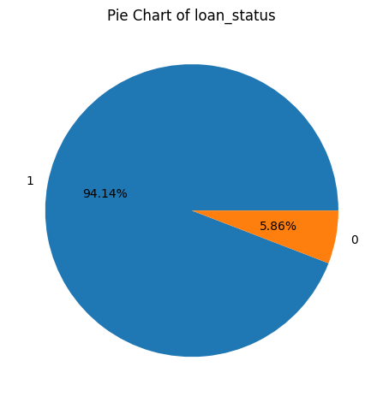
This the distribution of the predictions we get on the new dataset.
import matplotlib.pyplot as plt
# Select the column you want to create a pie chart for
feature_column = 'loan_status'
# Calculate the value counts and percentages
value_counts = df[feature_column].value_counts()
percentages = value_counts / len(df) * 100
# Add a title to the chart
plt.title("Pie Chart of {}".format(feature_column))
# Add the percentages as text outside each slice
_, _, autotexts = plt.pie(value_counts, labels=value_counts.index, autopct='%.2f%%')
for autotext in autotexts:
autotext.set_horizontalalignment('center')
autotext.set_verticalalignment('center')
# Display the chart
plt.tight_layout()
# 1 Means PAID
# 0 means DEFAULTED

Slide 30
END

